Slide 1
Algorithm Design Techniques

Slide 2
Greedy Method
A greedy algorithm is an approach for solving a problem by selecting the best option available at the moment. It doesn't worry whether the current best result will bring the overall optimal result.
The algorithm never reverses the earlier decision even if the choice is wrong. It works in a top-down approach.
This method is used for solving optimization problems.

Slide 3
When to Use Greedy
1. Greedy Choice Property
If an optimal solution to the problem can be found by choosing the best choice at each step without reconsidering the previous steps once chosen, the problem can be solved using a greedy approach. This property is called greedy choice property.
2. Optimal Substructure
If the optimal overall solution to the problem corresponds to the optimal solution to its subproblems, then the problem can be solved using a greedy approach. This property is called optimal substructure.

Slide 4
Basic Structure
Algorithm Greedy (a, n)
{
Solution : = 0;
for i = 0 to n do
{
x: = select(a);
if feasible(solution, x)
{
Solution: = union(solution , x)
}
return solution;
} }
declare an empty result = 0.
We make a greedy choice to select, If the choice is feasible add it to the final result.
return the result.

Slide 5
Applications
Greedy algorithms are used to find an optimal or near optimal solution to many real-life problems. Few of them are listed below:
(1) Make a change problem
(2) Knapsack problem
(3) Minimum spanning tree
(4) Single source shortest path
(5) Activity selection problem
(6) Job sequencing problem
(7) Huffman code generation.

Slide 6
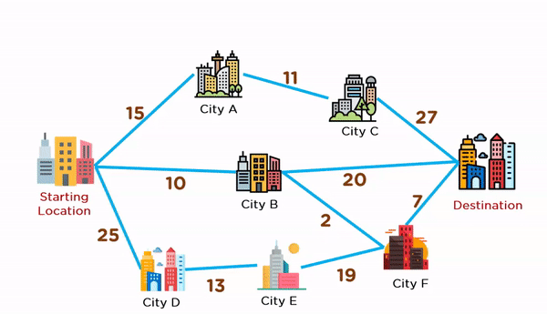
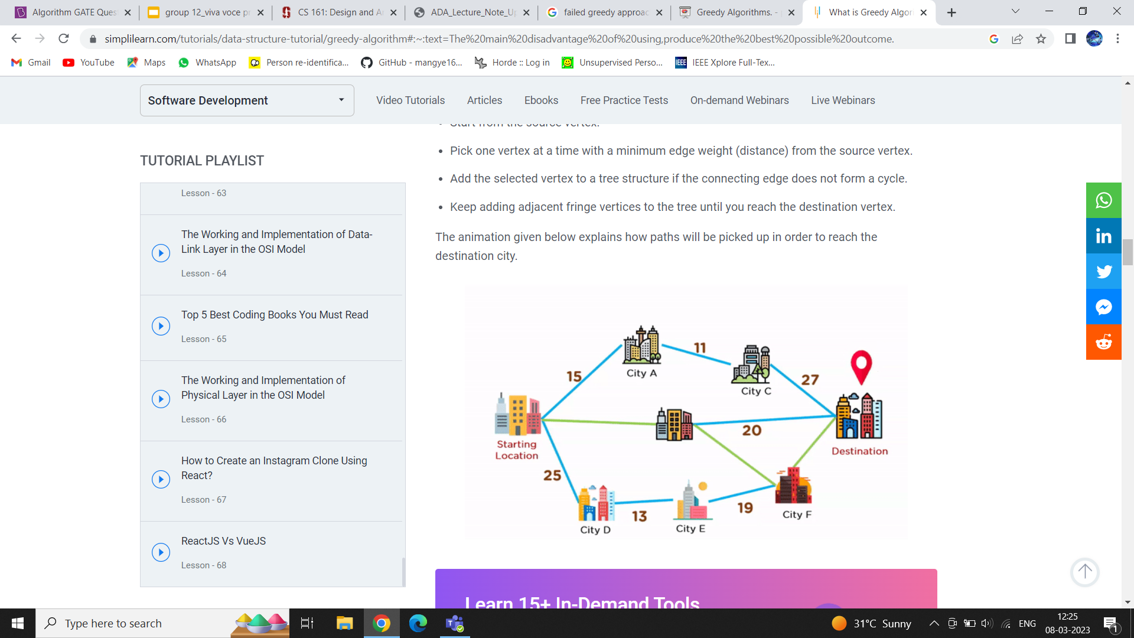
Example

Slide 7
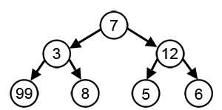
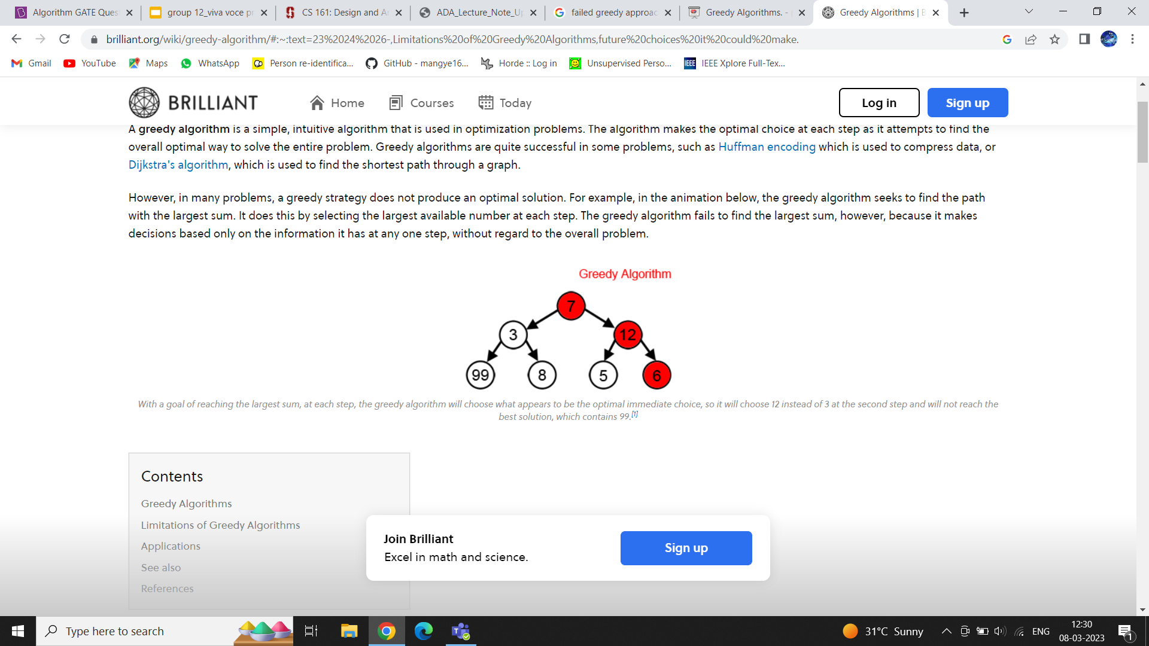
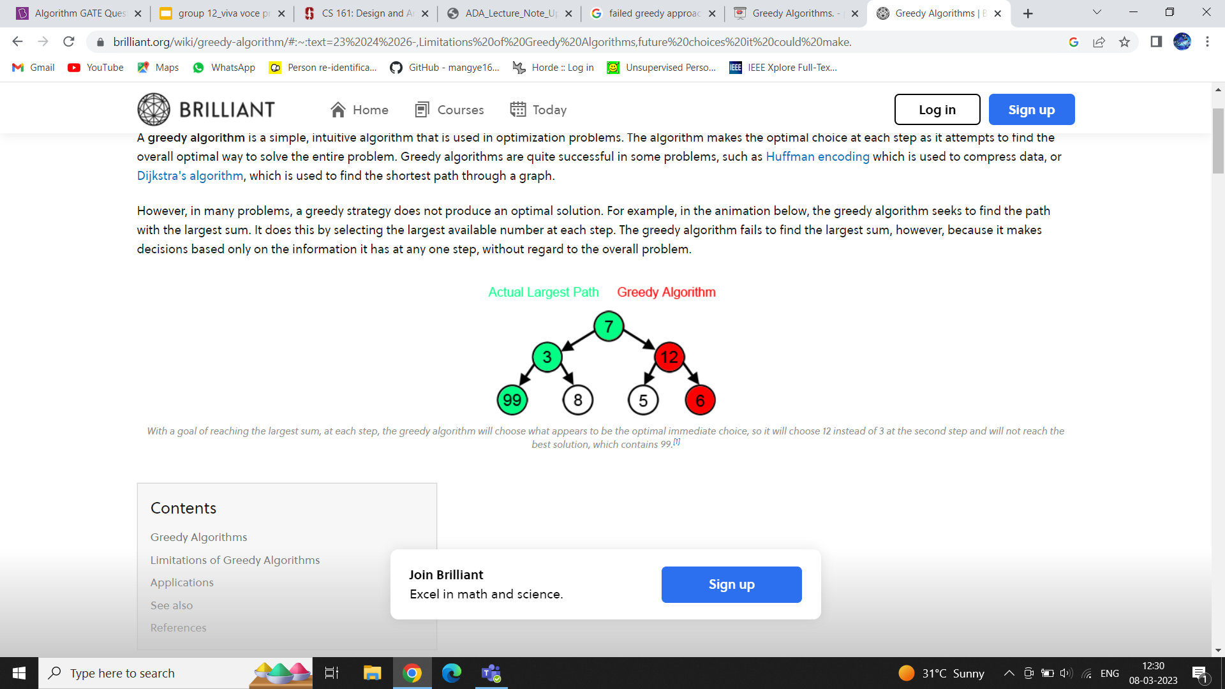
Drawbacks
The local optimal solution may not always be globally optimal.
For example, greedy fails to find the largest path in the below tree. Because it only considers local optimal value.

Slide 8
Dynamic Programming
Dynamic Programming is mainly an optimization over plain recursion.
Wherever we see a recursive solution that has repeated calls for same inputs, we can optimize it using Dynamic Programming.
The idea is to simply store the results of subproblems, so that we do not have to re-compute them when needed later.
This simple optimization reduces time complexities from exponential to polynomial.

Slide 9
Dynamic Programming
Dynamic programming is a way of improving on inefficient divide-and-conquer algorithms.
By inefficient, we mean that the same recursive call is made over and over.
If same subproblem is solved several times, we can use table to store result of a subproblem the first time it is computed and thus never have to recompute it again.
Dynamic programming is applicable when the subproblems are dependent.

Slide 10
Techniques to solve Dynamic Programming Problems
1. Top-Down (Memoization):
Break down the given problem in order to begin solving it. If you see that the problem has already been solved, return the saved answer. If it hasn’t been solved, solve it and save it. This is usually easy to think of and very intuitive, This is referred to as Memoization.
2. Bottom-Up (Dynamic Programming):
Analyze the problem and see in what order the subproblems are solved, and work your way up from the trivial subproblem to the given problem. This process ensures that the subproblems are solved before the main problem. This is referred to as Dynamic Programming.

Slide 11
How to solve a Dynamic Programming Problem
To dynamically solve a problem, we need to check two necessary conditions:
Overlapping Subproblems: When the solutions to the same subproblems are needed repetitively for solving the actual problem. The problem is said to have overlapping subproblems property.
Optimal Substructure Property: If the optimal solution of the given problem can be obtained by using optimal solutions of its subproblems then the problem is said to have Optimal Substructure Property.

Slide 12
Basic Structure
Identify if it is a Dynamic programming problem.
Decide a state expression with the Least parameters.
Formulate state and transition relationships.
Do tabulation (or memorization).

Slide 13
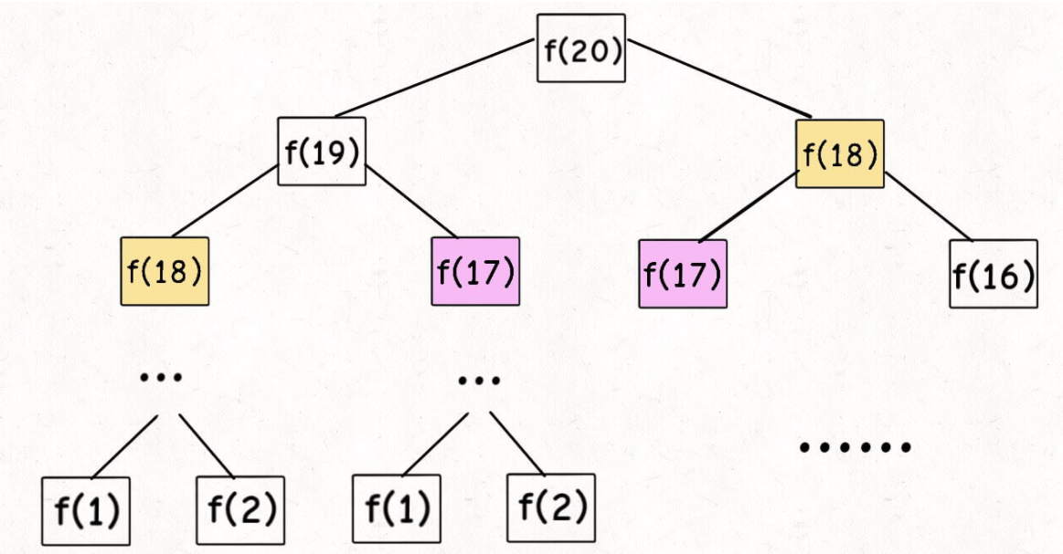
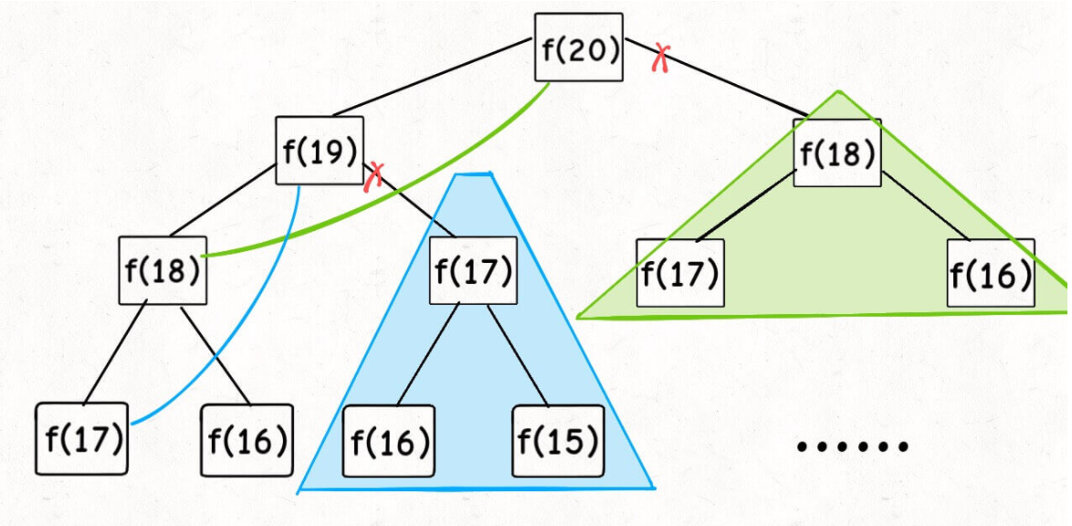
Example: Fibonacci Numbers
fib(n)=fib(n-1)+fib(n-2)

Slide 14
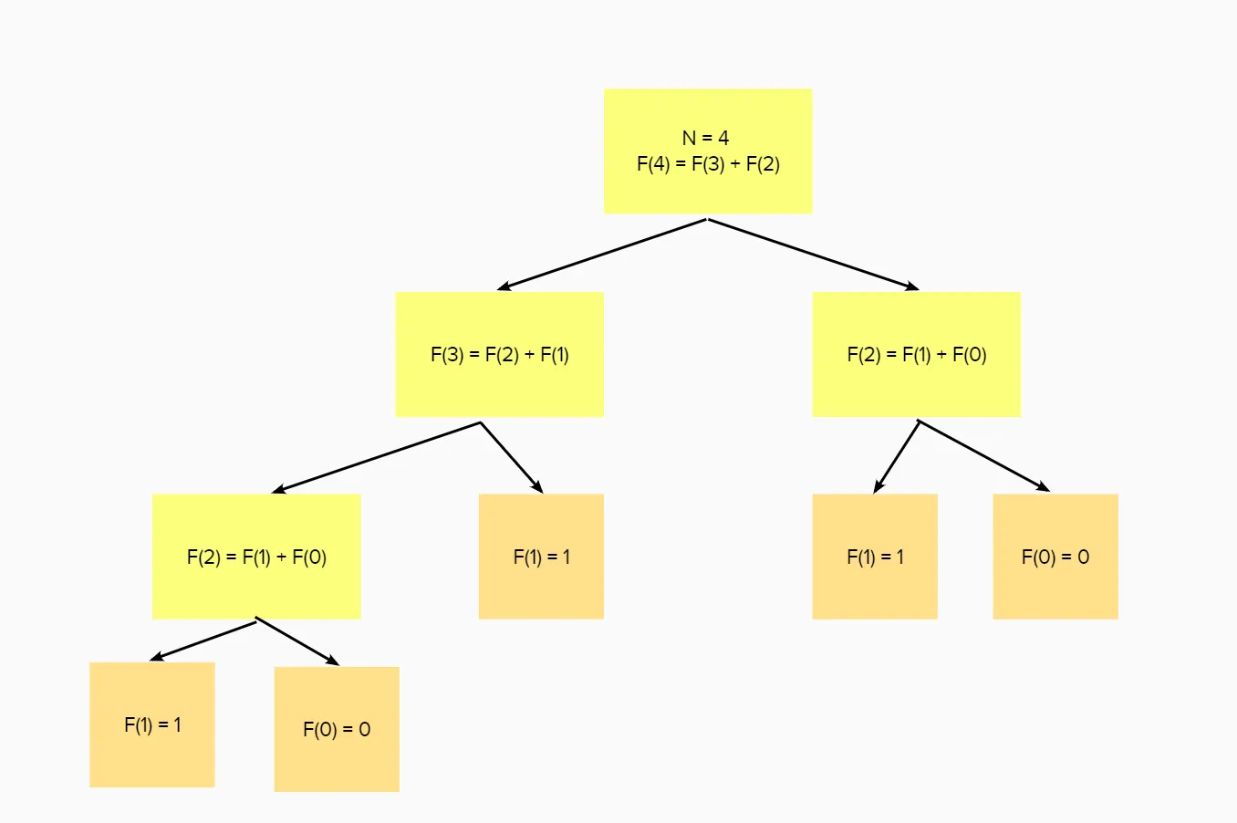
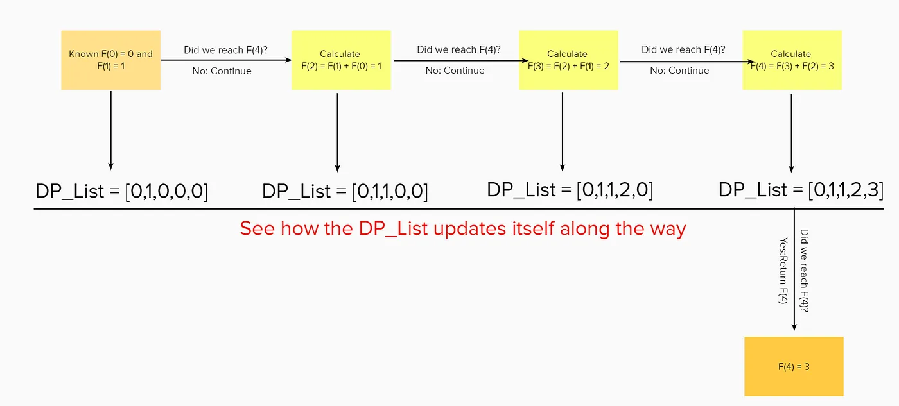
Fibonacci Example
Recursion
O(2ⁿ)
Dynamic Programming
O(n)

Slide 15
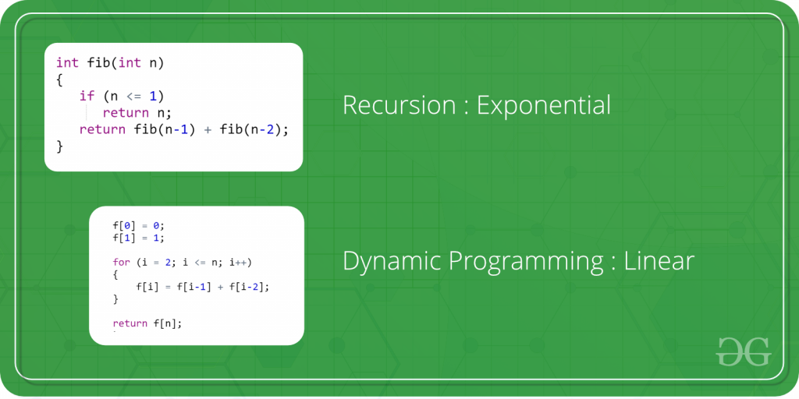
Example
Computing Fibonacci Numbers
Recursion: Exponential
Dynamic Programming: Linear

Slide 16
Questions
1. What happens when a top-down approach to dynamic programming is applied to a problem?
(A) It increases both the time and space complexity
(B) It decreases the time complexity and increases the space complexity
(C) It decreases the space complexity and increases the time complexity
(D) It decreases both the time and space complexity
Answer: (B)
Explanation: As the mentioned approach uses the memoization technique, it always stores the previously calculated values. Due to this, the time complexity decreases, but the space complexity increases.

Slide 17
Questions
2. If we can break a problem into subproblems that are reused many times, the problem is said to possess which of the following property?
(A) Overlapping subproblems
(B) Greedy
(C) Memoization
(D) Optimal substructure
Answer: (A)
Explanation: The problems which have the property in which the value of a subproblem is used several times is said to possess the property of Overlapping subproblems.

Slide 18
GRAPH TRAVERSAL
Graph traversal technique is used for visiting every vertex of graph G once in a well-defined order.
A graph might have cycles and we might not be able to traverse the entire graph from a single vertex (for example, if the graph is not connected). Therefore, we must keep track of the vertices that have been visited. With graph traversal, we can visit all the vertices of the graph without getting into a looping path.
The order in which the vertices are visited are important and may depend upon the algorithm or question that you are solving.
There are two graph traversal techniques:
1. DFS (Depth- First Search)
2. BFS (Breadth-First Search)

Slide 19
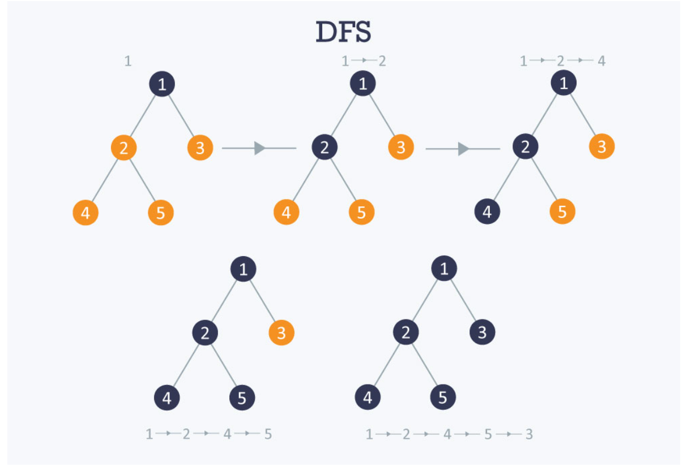
DFS
The DFS algorithm is a recursive algorithm that
uses the idea of backtracking. It involves
exhaustive searches of all the nodes by going
ahead, if possible, else by backtracking.
ALGORITHM STEPS :
Start by putting any one of the graph's
Vertices on top of a stack.
Take the top item of the stack and add it to
The visited list.
Create a list of that vertex's adjacent nodes. Add the ones which aren't in the visited list to the top of the stack.
Keep repeating steps 2 and 3 until the stack is empty.

Slide 20
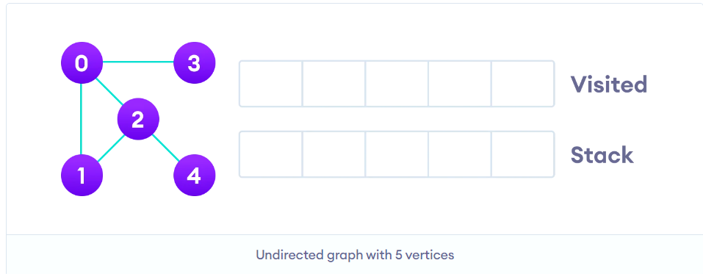
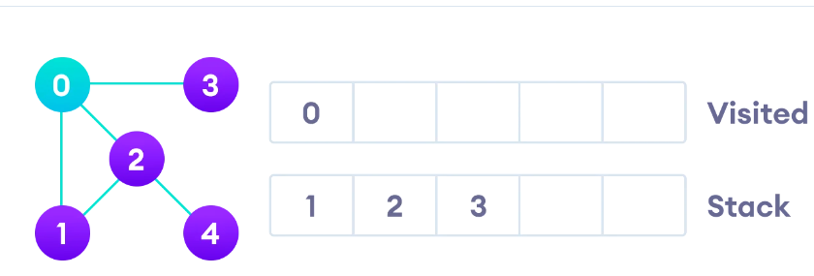
EXAMPLE :

Slide 21
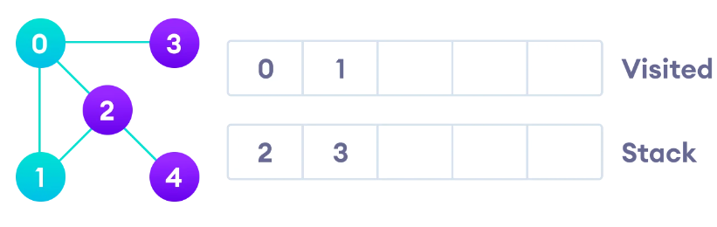
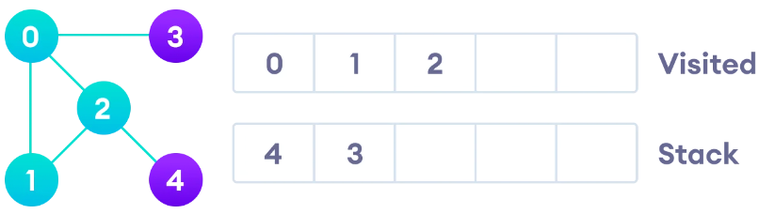

Slide 22
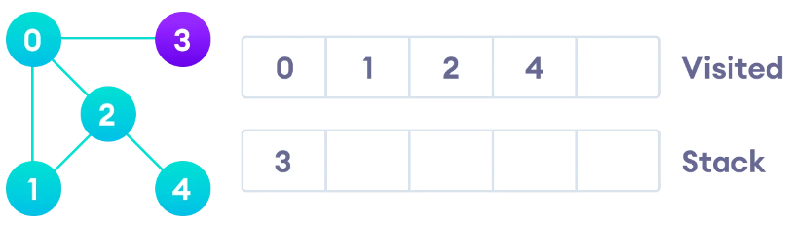
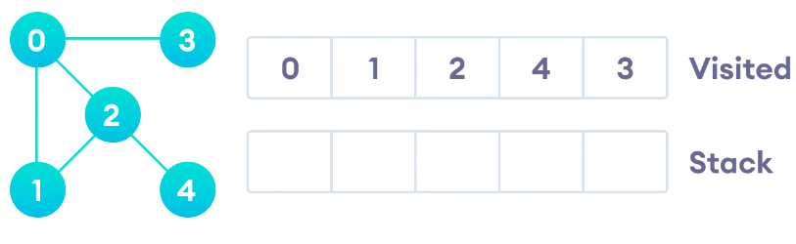

Slide 23
Complexity Analysis of DFS
Time complexity: O(V + E), where V is the number of vertices and E is the number of edges in the graph.
Space Complexity: O(V).
Since, an extra visited array is needed of size V.
Application of DFS
For finding the path
To test if the graph is bipartite
For finding the strongly connected components of a graph
For detecting cycles in a graph

Slide 24
BFS
Breadth-first search graph traversal techniques use a queue data structure as an auxiliary data structure to store nodes for further processing. The size of the queue will be the maximum total number of vertices in the graph.
Steps to implement BFS traversal:
Step 1 - Define a Queue of size total number of vertices in the graph.
Step 2 - Select any vertex as starting point for traversal. Visit that vertex and insert it into the Queue.
Step 3 - Visit all the non-visited adjacent vertices of the vertex which is at front of the Queue and insert them into the Queue.
Step 4 - When there is no new vertex to be visited from the vertex which is at front of the Queue then delete that vertex.
Step 5 - Repeat steps 3 and 4 until queue becomes empty.
Step 6 - When queue becomes empty, then produce final spanning tree by removing unused edges from the graph

Slide 25
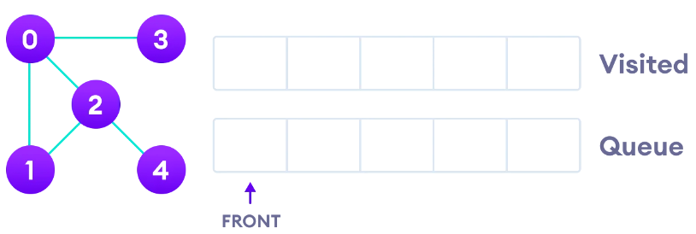
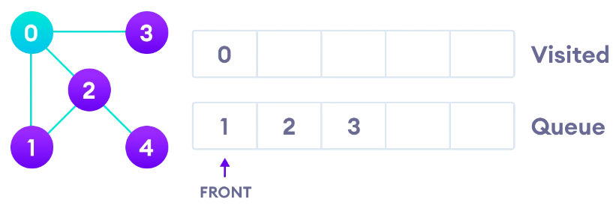
EXAMPLE :

Slide 26
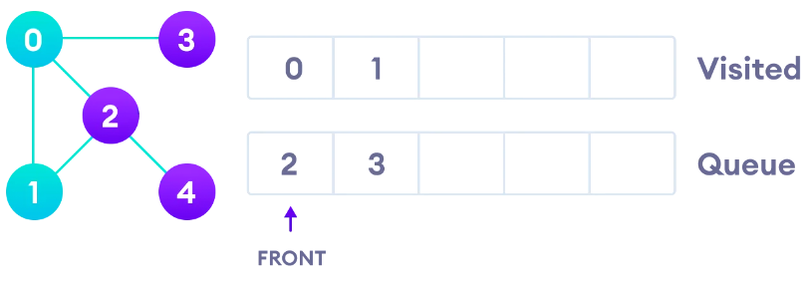
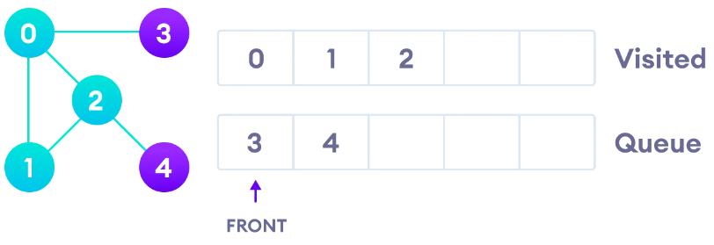

Slide 27
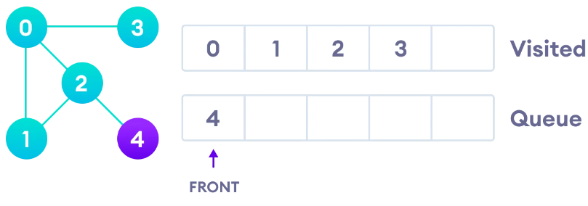
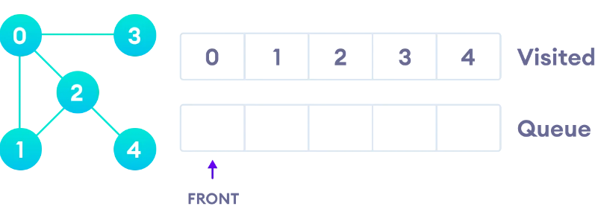

Slide 28
Complexity Analysis of BFS
Time complexity: O(V + E), where V is the number of vertices and E is the number of edges in the graph.
Space Complexity: O(V).
Since, an extra visited array is needed of size V.
Applications of BFS
In minimum spanning trees
To build index by search index
For GPS navigation
Path finding algorithms
In Ford-Fulkerson algorithm to find maximum flow in a network
Cycle detection in an undirected graph

Slide 29
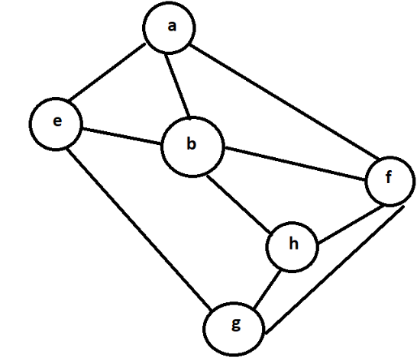
QUESTION :
Consider the following graph,Among the following sequences,Which is not the depth-first traversals of the graph?
(I) a b e g h f
(II) a b f e h g
(III) a b f h g e
(IV) a f g h b e
Answer : B
Explanation : In DFS, if a 'v' vertex is visited after 'u,' one of the following is true
1) (u, v) is an edge.
2) 'u' is a leaf node (doesn’t have any unvisited adjacent nodes).

Slide 30
Minimum Spanning Tree
What is a Spanning Tree?
Given an undirected and connected graph G, a spanning tree of the graph G is a tree that spans G (that is, it includes every vertex of G) and is a subgraph of G (every edge in the tree belongs to G).
What is a Minimum Spanning Tree?
The cost of the spanning tree is the sum of the weights of all the edges in the tree. There can be many spanning trees. Minimum spanning tree is the spanning tree where the cost is minimum among all the spanning trees. There also can be many minimum spanning trees.
Minimum spanning tree has direct application in the design of networks. It is used in algorithms approximating the travelling salesman problem, multi-terminal minimum cut problem and minimum-cost weighted perfect matching.

Slide 31
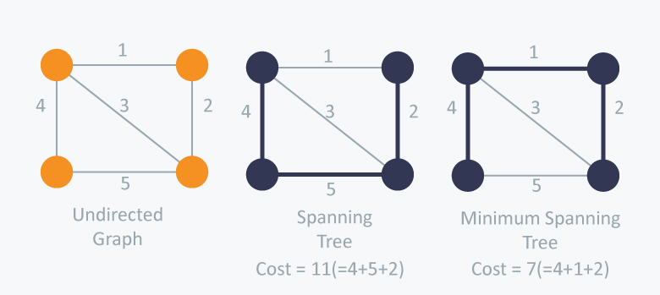

Slide 32
Kruskal’s Algorithm
Kruskal’s Algorithm builds the spanning tree by adding edges one by one into a growing spanning tree. Kruskal's algorithm follows greedy approach as in each iteration it finds an edge which has least weight and add it to the growing spanning tree.
Algorithm Steps:
Sort all the edges in non-decreasing order of their weight.
Pick the smallest edge. Check if it forms a cycle with the spanning tree formed so far. If the cycle is not formed, include this edge. Else, discard it.
Repeat step #2 until there are (V-1) edges in the spanning tree.

Slide 33
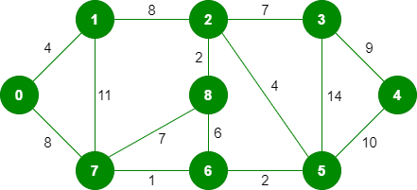
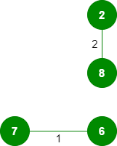
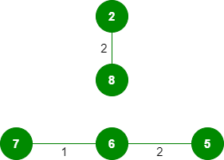


Slide 34
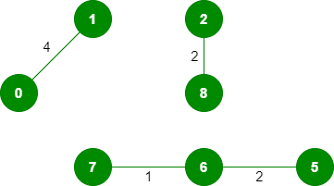

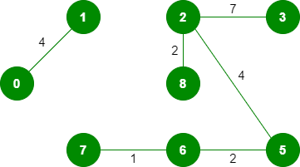
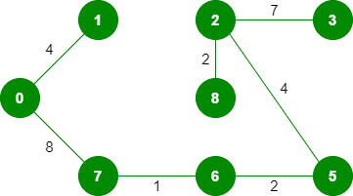

Slide 35
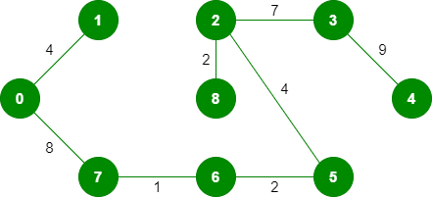
The final structure of MST

Slide 36
Prim’s Algorithm
Prim’s Algorithm also use Greedy approach to find the minimum spanning tree. In Prim’s Algorithm we grow the spanning tree from a starting position. Unlike an edge in Kruskal's, we add vertex to the growing spanning tree in Prim's.
Algorithm Steps:
Maintain two disjoint sets of vertices. One containing vertices that are in the growing spanning tree and other that are not in the growing spanning tree.
Select the cheapest vertex that is connected to the growing spanning tree and is not in the growing spanning tree and add it into the growing spanning tree. This can be done using Priority Queues. Insert the vertices, that are connected to growing spanning tree, into the Priority Queue.
Check for cycles. To do that, mark the nodes which have been already selected and insert only those nodes in the Priority Queue that are not marked.

Slide 37
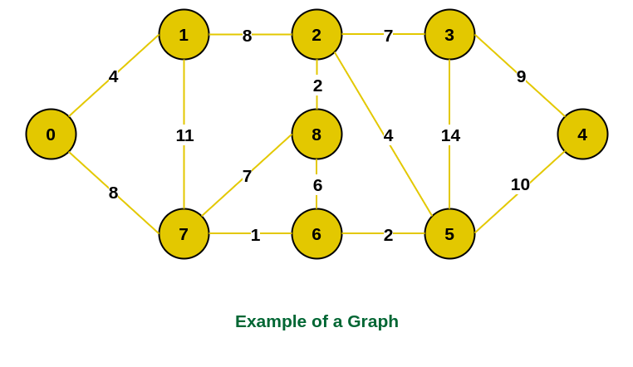
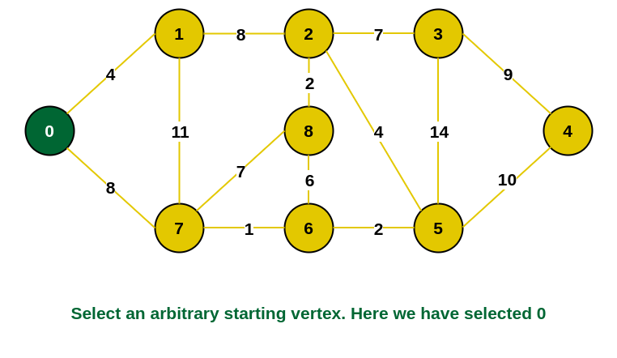

Slide 38
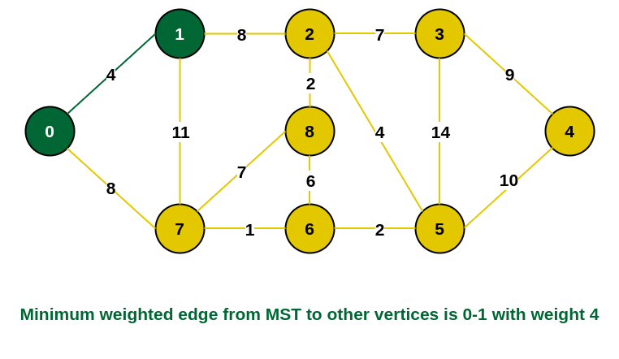
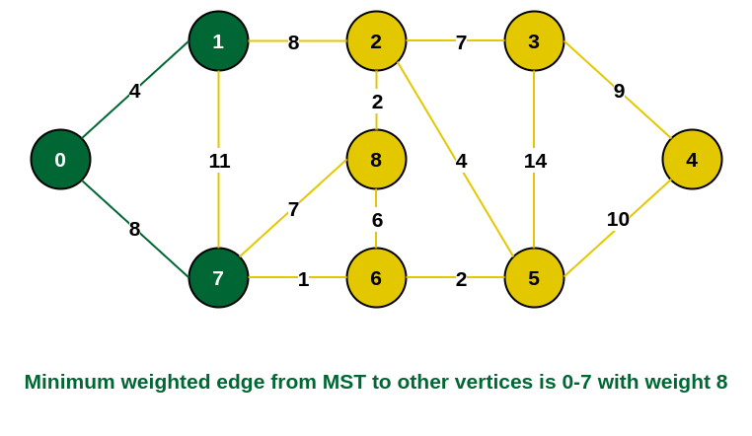

Slide 39
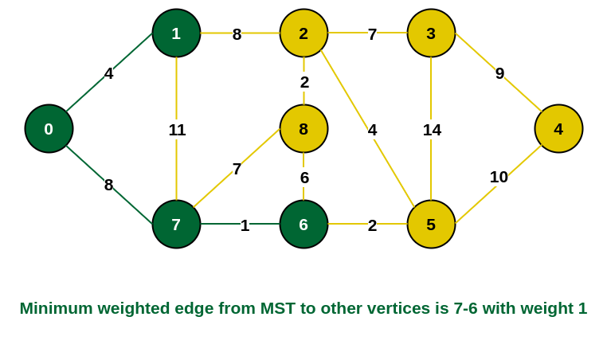
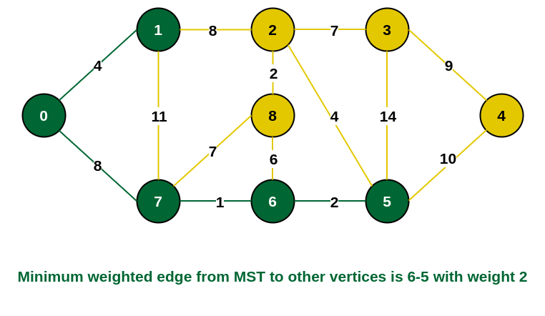

Slide 40
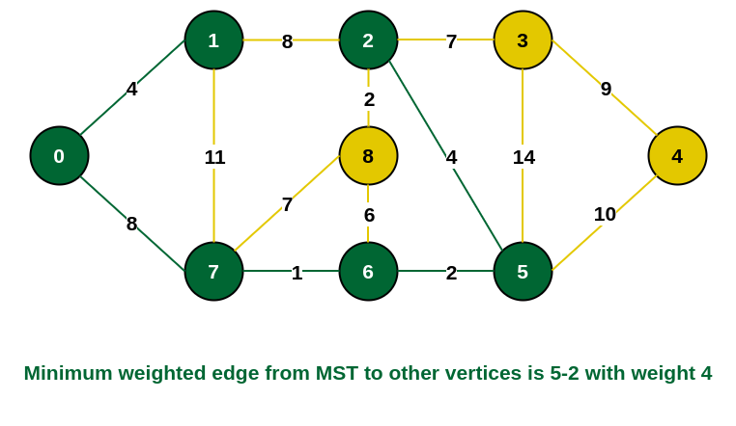
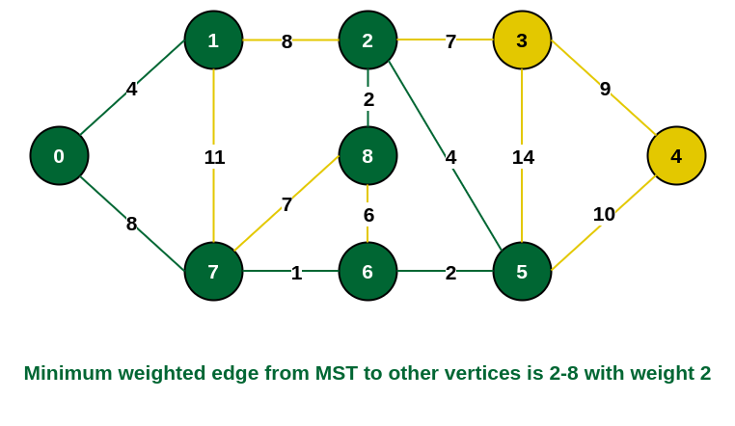

Slide 41
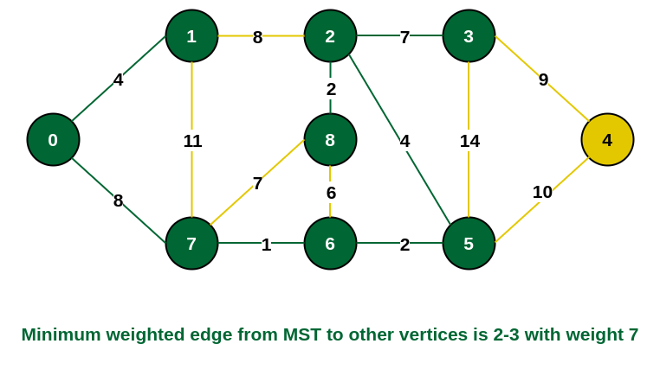
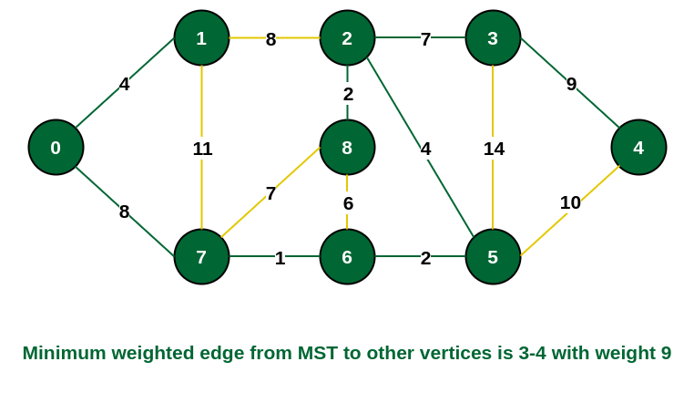

Slide 42
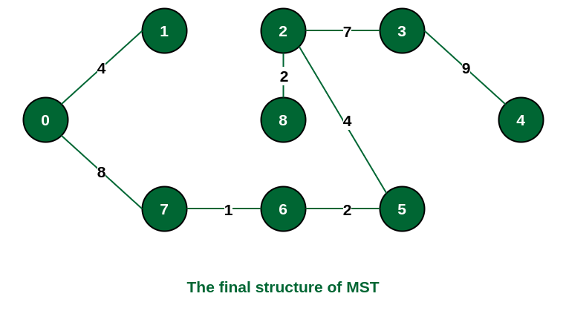
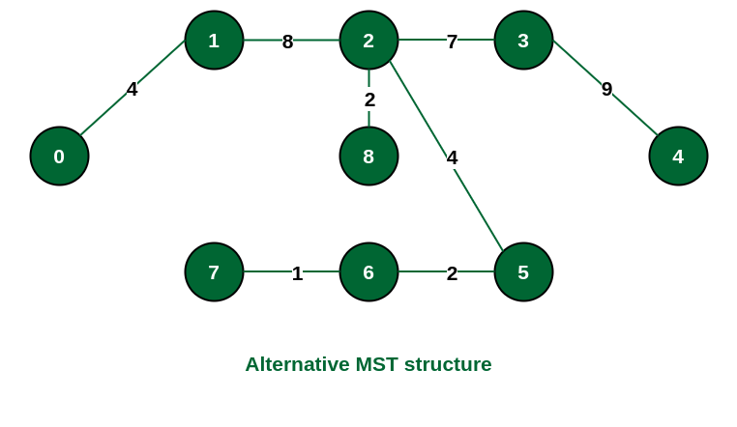

Slide 43
Differences
In Kruskal’s algorithm,
Time Complexity: O(ElogE) or O(ElogV)
Auxiliary Space: O(V + E)
Applications: LAN connection, TV Network
Can generate Forest (disconnected components) and also works on disconnected components
2. In Prim’s Algorithm,
Time complexity: usually O(V²), improvised O(E Log V)
Auxiliary Space: O(V)
Applications: Travelling salesman Problem, Networks for roads and railway tracks connecting all cities
Gives connected components and works only on connected graphs

Slide 44
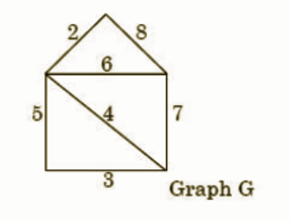
Question
The weight of minimum spanning tree in graph G, calculated using Kruskal’s algorithm is:
14
15
17
18

Slide 45
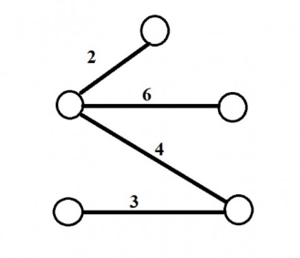
ANSWER: Total cost of the minimum spanning tree is ( 2 + 3 + 4 + 6 ) = 15

Slide 46
Shortest Path Algorithms
The shortest path problem is about finding a path between vertices in a graph such that the total sum of the edges weights is minimum.
This problem could be solved easily using (BFS) if all edge weights were 1, but here weights can take any value.
Three different algorithms are:
Bellman Ford's Algorithm
Dijkstra's Algorithm
Floyd Warshall's Algorithm

Slide 47
Bellman Ford's Algorithm
Initially all vertices have a distance of "Infinity", but only the distance of the source vertex = 0
Algorithm Steps:
The outer loop traverses from 0 to n-1.
Loop over all edges, check if the next node distance > current node distance + edge weight, in this case update the next node distance to "current node distance + edge weight".
Now, update all the connected vertices with the new distances (source vertex distance + edge weights), then apply the same concept for the new vertices with new distances and so on.
This algorithm depends on the relaxation principle where the shortest distance for all vertices is gradually replaced by more accurate values until eventually reaching the optimum solution.

Slide 48
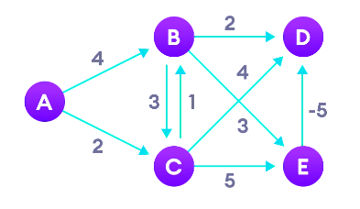
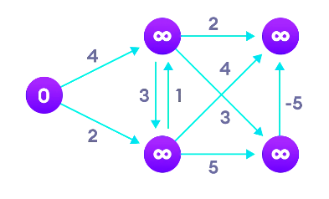
Example:
Start with weighted graph
Choose a starting vertex and assign infinity path values to all other vertices

Slide 49
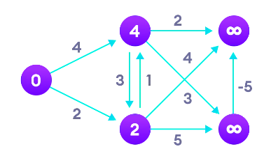
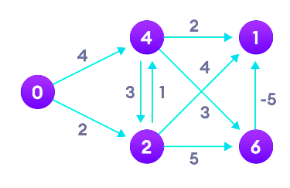
Visit each edge and relax the path distances if they are inaccurate
We need to do this v times.

Slide 50
A very important application of Bellman Ford is to check if there is a negative cycle in the graph.
Time Complexity of Bellman Ford algorithm is relatively high O(V.E).
Since we are using an auxiliary array dis of size V, the space complexity is O(V).
Here, V = number of Vertices
E = number of Edges

Slide 51
Dijkstra's Algorithm
Dijkstra's algorithm has many variants but the most common one is to find the shortest paths from the source vertex to all other vertices in the graph.
Algorithm Steps:
Set all vertices distances = infinity except for the source vertex, set the source distance = 0.
Push the source vertex in a min-priority queue in the form (distance , vertex), as the comparison in the min-priority queue will be according to vertices distances.
Pop the vertex with the minimum distance from the priority queue (at first the popped vertex = source).
Update the distances of the connected vertices to the popped vertex in case of "current vertex distance + edge weight < next vertex distance", then push the vertex with the new distance to the priority queue.
If the popped vertex is visited before, just continue without using it.
Apply the same algorithm again until the priority queue is empty.

Slide 52


Example:
Choose a starting vertex and assign infinity path values to all other devices
Start with weighted graph

Slide 53


Go to each vertex and update its path length
If path length of adjacent vertex is lesser than new path length, dont update it

Slide 54


After each iteration, we pick the unvisited vertex with the least path length.
Avoid updating path lengths of already visited vertices.

Slide 55
A very important application of Dijkstra's Algorithm is to find the shortest path in social networking applications
Time Complexity is O(E log V).
Space complexity is O(V).
Here, V = number of Vertices
E = number of Edges

Slide 56
Floyd Warshall's Algorithm
Floyd Warshall's Algorithm is used to find the shortest paths between between all pairs of vertices in a graph, where each edge in the graph has a weight which is positive or negative.
Algorithm steps:
Initialize the shortest paths between any 2 vertices with Infinity.
Find all pair shortest paths that use 0 intermediate vertices, then find the shortest paths that use 1 intermediate vertex and so on.. until using all N vertices as intermediate nodes.
Minimize the shortest paths between any 2 pairs in the previous operation.
For any 2 vertices (i, j), one should actually minimize the distances between this pair using the first K nodes, so the shortest path will be: min(dist[i][k] + dist[hk][j], dist[i][j]).
Dist[i][k] represents the shortest path that only uses the first K vertices, dist[k][j] represents the shortest path between the pair k, j. As the shortest path will be a concatenation of the shortest path from i to k, then from k to j.

Slide 57


Example:

Slide 58





Slide 59
There are three loops. Each loop has constant complexities. So, the time complexity of the Floyd-Warshall algorithm is O(V³).
he space complexity of the Floyd-Warshall algorithm is O(V²).
Here, V = number of Vertices
E = number of Edges

